Slide 1
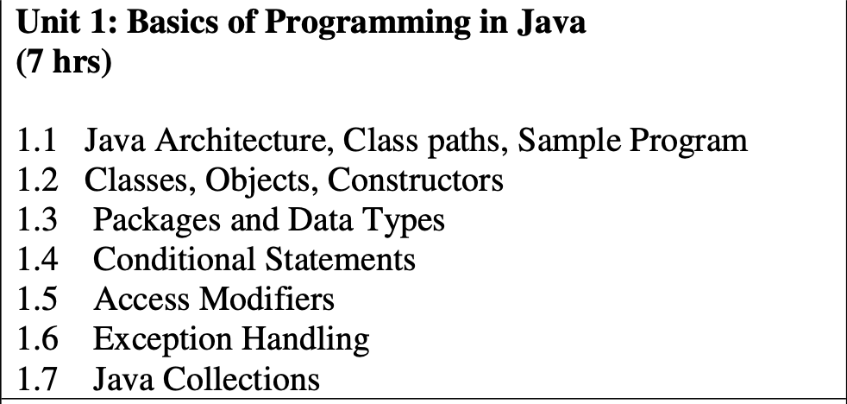

Slide 2
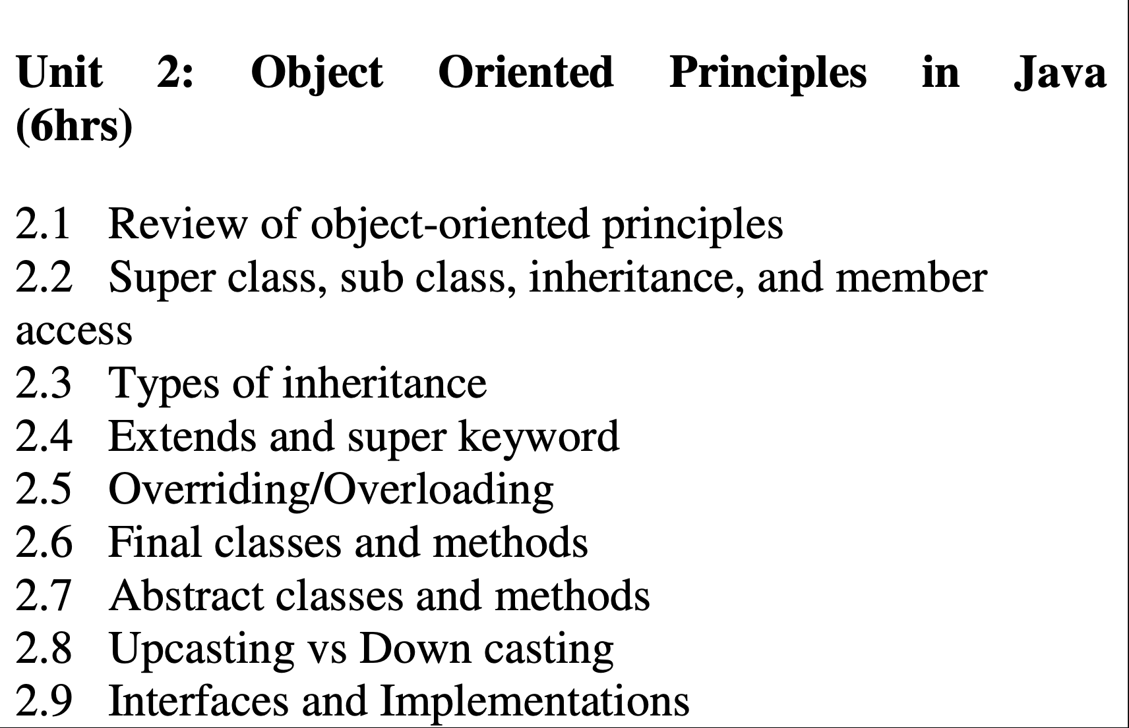

Slide 3
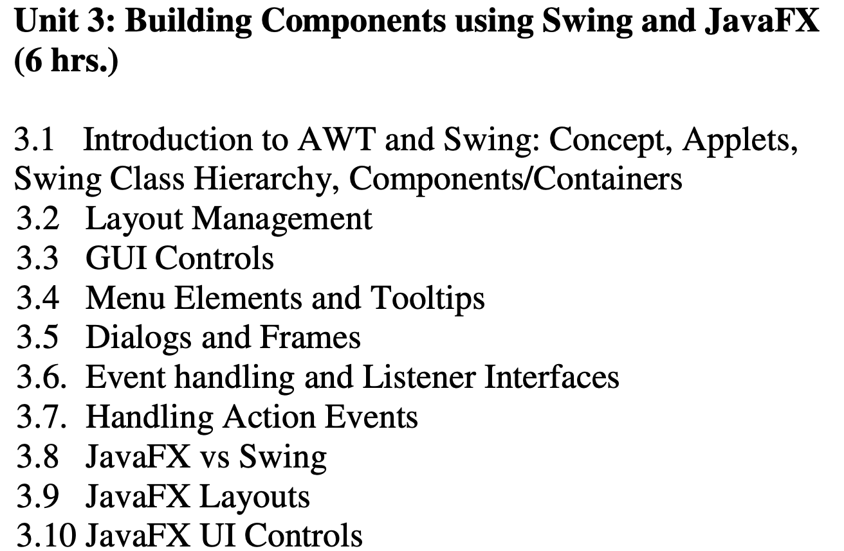

Slide 4
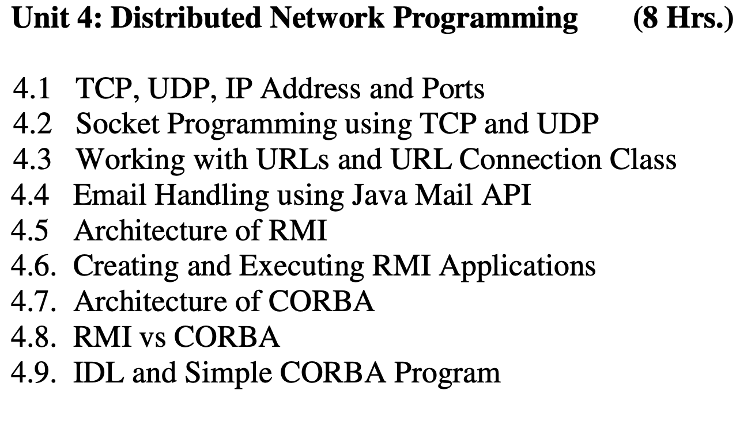

Slide 5
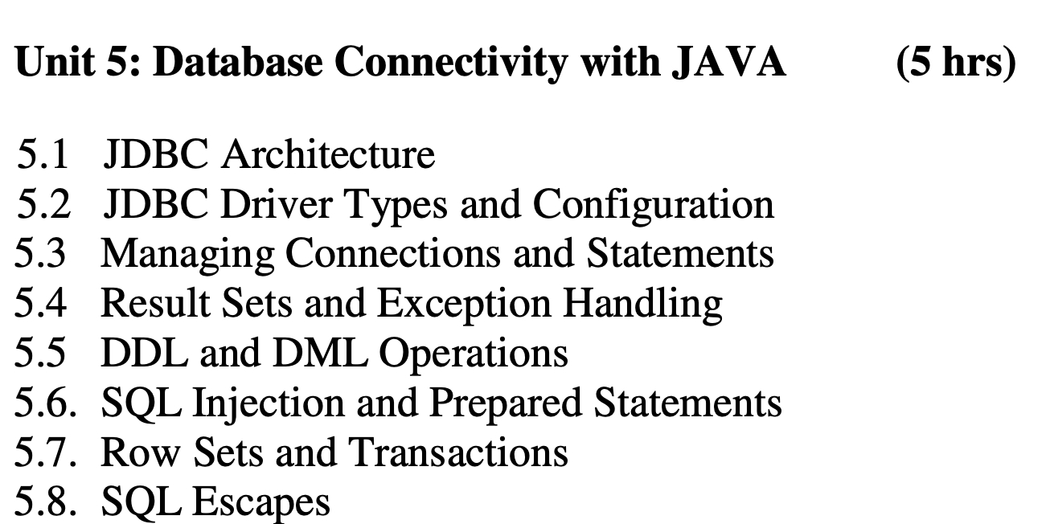

Slide 6
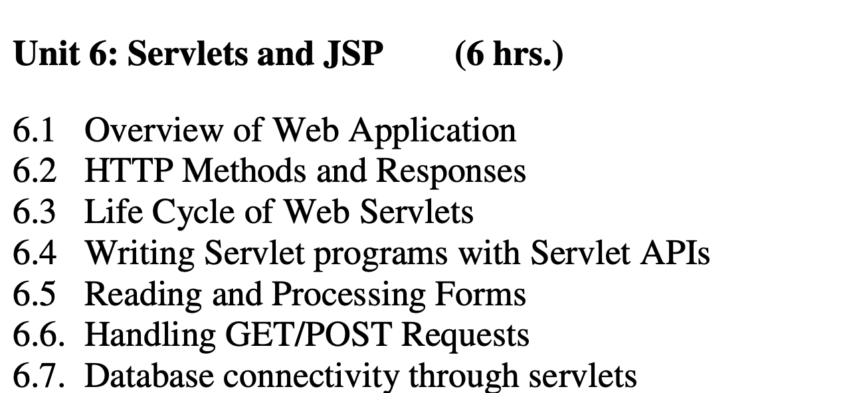

Slide 7
Advanced Topics in JAVA

Slide 8
Outline
Overview of ORM
Hibernate
Web Framework Introduction
Basics of Spring Boot
Concurrency and Multithreading in JAVA
Design Patterns: Singleton, Factory and Abstract Factory

Slide 9
Overview of ORM
An ORM tool is software designed to help OOP developers interact with relational databases.
So instead of creating your own ORM software from scratch, you can make use of these tools.
Simplifies the interaction between a relational database and the application by mapping database tables to objects.
Removes the need for complex SQL queries, allowing developers to work with objects instead.

Slide 10
Hibernate
A powerful Java-based ORM framework that simplifies database interactions.
Provides an abstraction layer over JDBC, managing database connections and transactions.
Reduces the need for manual SQL coding and database-specific handling, making database interactions more intuitive.
Without Hibernate: Manually handling JDBC connections, SQL queries, and result sets.
With Hibernate: Defining entities, mapping relationships, and relying on Hibernate to handle database interactions

Slide 11
What is a Framework
A framework is a structure that you can build software on
It serves as a foundation, so you’re not starting entirely from scratch
Frameworks are typically associated with a specific programming language and are suited to different types of tasks
Let’s say you’re building a house.
You could pour the foundation and frame the house yourself. It would take a lot of time, but you could do it.
If all of that were already done for you, though, it would save you quite a bit of effort — especially if it was done by expert home builders.
In software development, a framework serves a similar purpose.
It’s designed and tested by other Software Developers and Engineers, so you know it’s a solid foundation.

Slide 12
Web Framework Introduction
A web framework, also known as a web application framework, is a software framework designed to assist in developing web applications, including web services, resources, and APIs.
The primary goal of web frameworks is to provide a standardized approach for creating and deploying web applications on the World Wide Web.
Web frameworks aim to automate common tasks in web development to reduce the associated overhead.
Examples of tasks handled by web frameworks include database access, templating, and session management.
The use of web frameworks promotes code reuse, making it easier to build and maintain web applications.
While web frameworks are commonly associated with dynamic websites, they are also applicable to static websites.

Slide 13
What is Spring in Java
Spring is a lightweight and popular open-source Java-based framework developed by Rod Johnson in 2003
It is used to develop enterprise-level applications
It provides support to many other frameworks such as Hibernate
Spring framework can be used for several tasks, including:
Developing serverless applications
Building scalable microservices
Securing the server-side of your application
Asynchronous application development
Automating tasks by creating batches
An event-driven architecture

Slide 14
Basics of Spring Boot
Spring Boot simplifies the configuration and development of Spring applications.
Promotes convention over configuration, reducing boilerplate code.
Minimizes the complexities of setting up a Spring application and allows developers to focus on business logic.
Without Spring Boot: Manually configuring various Spring components.

Slide 15
Basics of Sprint Boot (contd...)
Spring Boot reduces development time, helps avoid unnecessary configuration and many other benefits, like:
You can use it to create standalone applications
There is no need to deploy WAR files while using SpringBoot
It doesn't require XML configuration
Embeds Tomcat, Jetty and Undertow directly
Offers production-ready features
SpringBoot is easier to launch
Easier customization and management

Slide 16
Spring v/s Spring Boot
Feature | Spring | Spring Boot
Configuration | Requires extensive XML configuration. | Embraces convention over configuration.
Setup and Development | More manual setup and configuration. | Streamlined setup with defaults and auto-configuration.
Dependency Management | Manual dependency management in the XML file. | Dependency management through Maven or Gradle.
Ease of Development | More explicit configuration and boilerplate code. | Reduces boilerplate code and simplifies configuration.
Embedded Servers | Requires manual configuration of servers. | Embedded servers (like Tomcat) are included by default.
Microservices Architecture | Supports microservices but with more setup. | Well-suited for microservices with built-in features.
Use Cases | Ideal for large-scale enterprise applications. | Suitable for a wide range of applications, especially microservices.

Slide 17
Concurrency and Multithreading in JAVA
Enables parallel execution, improving application performance.
Essential for developing responsive and efficient applications.
Addresses the challenges of managing multiple threads, preventing race conditions and ensuring thread safety.
Without Concurrency: Single-threaded applications may face performance bottlenecks.
With Concurrency: Utilizing multiple threads to perform tasks concurrently.

Slide 18
Design Patterns: Singleton, Factory and Abstract Factory
Design patterns are proven solutions to recurring design problems.
Improves code readability, maintainability, and scalability.
Singleton: Ensures a class has only one instance and provides a global point of access to it.
Factory: Defines an interface for creating an object but leaves the choice of its type to the subclasses.
Abstract Factory: Provides an interface for creating families of related or dependent objects without specifying their concrete classes.

Slide 19
Singleton Pattern
The Singleton pattern ensures that only one instance of a class is created and provides a global point of access to it.
It is useful in scenarios where you want to restrict the instantiation of a class to a single object throughout the application.

Slide 20
Singleton Pattern: Example
Suppose you have a database connection class that needs to be accessed by multiple parts of your application.
You can use the Singleton pattern to ensure that only one instance of the database connection is created and shared across the application.
The Singleton class would typically have a static method that returns the single instance, and the constructor of the class would be made private to prevent direct instantiation.
This ensures that all parts of the application access the same instance of the database connection, promoting efficient resource utilization and consistency.

Slide 21
Factory Pattern
The Factory pattern provides an interface or base class for creating objects, but allows subclasses or implementing classes to decide which concrete class to instantiate.
It abstracts the process of object creation and provides a way to create objects without specifying their exact classes.

Slide 22
Factory Pattern: Example
Consider a pizza ordering application.
The Factory pattern can be used to define a PizzaFactory class with a method for creating different types of pizzas. The PizzaFactory class would have methods like createMargheritaPizza(), createPepperoniPizza(), and so on, each returning a specific type of pizza object.
The client code can then use the PizzaFactory to create pizzas without being concerned about the specific pizza class being instantiated.
This allows for flexibility and easy addition of new pizza types without modifying the client code.

Slide 23
Abstract Factory Pattern
The Abstract Factory pattern provides an interface for creating families of related or dependent objects without specifying their concrete classes.
It allows the client code to work with abstract interfaces and classes, making it independent of the specific implementations.

Slide 24
Abstract Factory Pattern: Example
Suppose you are developing a GUI framework that supports multiple operating systems.
You can use the Abstract Factory pattern to define an abstract GUIFactory interface with methods like createButton() and createCheckbox().
Then, you can create concrete factory classes like WindowsGUIFactory and LinuxGUIFactory that implatform-specific implementations of the createButton() and createCheckbox() plement the GUIFactory interface and provide methods.
The client code can use the abstract GUIFactory interface to create buttons and checkboxes without knowing the specific platform it is running on. This promotes code modularity and easy integration with different operating systems.

Slide 25
Thank You

